Slide 1
NSL High Level Method v.1.14 (Final)

Slide 2
Document Control
Version History
Version | Date Issued | Issued to | Reason for New Version
V1.0 | 17.06.2014 | Application Solution Definition Workshop Participants | Adapted Native CDM pack for the Application Solution Definition Workshop adding in a Scenario (Account Closure), Pass 1 models for the scenario in all domains and Pass 2 model for Application Architecture
V1.1 | 19.06.2014 | Business Solutions Definition Workshop Participants | Added slides for Depicting Business Solutions Modeling elements under the business process (5 slides)
V1.2 | 19.06.2014 | Business Solutions Definition Workshop Participants | Added a task view of the method with complete task description
V1.3 | 23.06.2014 | Information Architecture SDW Participants | Included slides for Information Architecture Workshop Updates all task cards for input/ output consistency Split inputs to Program and Model inputs
V1.4 | 26.06.2014 | SOA Architecture SDW Participants | Slides included to cover Service Architecture and Design
V1.5 | 27.06.2014 | Infrastructure SDW Participants | Slides included to cover Infrastructure Architecture and Design
V1.6 | 01.07.2014 | Security SDW Participants | Slides included to cover Security Architecture and Design
V1.7 | 02.07.2014 | Business Process SDW Participants | Slides included to cover Business Process Architecture and Design
V1.8 | 03.07.2014 | Technical Design SDW Participants | Slides included to cover Technical Design
V1.9 | 09.07.2014 | Business Process 2 SDW Participants | Slides updated from previous workshops
V1.10 | 11.07.12014 | Customer Centricity SDW Participants | Slides updated from previous workshops and added Customer Journey slides
V1.11 | 15.07.2014 | End to End Workshop | Slides added to describe journey and where we have landed with the method in RMC
v.1.12 – v1.13 | 24.07.2014 | Internal | Updates to reflect changes to the framework (adding Operational risk and control) post the end to end workshop
V1.14 | 31.07.2014 | Design Authority | NSL Meta Model included with description of objects. Updated task cards to reflect final changes.

Slide 3
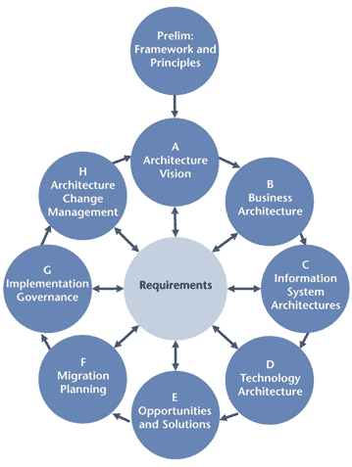
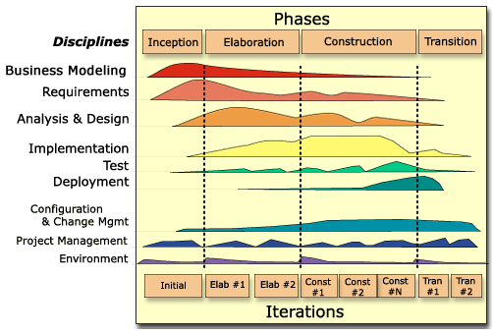
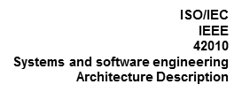

The Defender Method for NBS is based on EB’s Collaborative Design Method (CDM) Genesis of EB’s CDM
The framework below shows the coverage of Architecture and Design in EB’s Collaborative Design Method. CDM includes best (good) practices from industry standard frameworks while incorporating practical experience from defining and implementing solution methods in other organisations
TOGAF
Enterprise Continuum
Architecture Development Method
EB’s Method Delivery Experience Framework Definition and Method Content
splitting Technology Architecture into Infrastructure, Security and other Cross cutting concerns along with separating Service architecture
OMG BMM
Business Planning
Business Modeling
Business Motivation
Business Architecture
Rational Unified Process
Lifecycle concepts, phases, iterations and process steps & activities
Application
Architecture
Information
Architecture
Infrastructure
Architecture
Service
Architecture
Security Architecture
Application
Design
Data
Design
Infrastructure
Design
Services
Design
Models Views, Viewpoints and Architecture Description
UML, SOAml:
Standard notation for requirements, architecture and design modelling
Process, Method, Method Content, Task, Activity, role, Work products and illustrations
IBM SOMA
Service definition, SOA Architecture Style and Principles
CDM provides an agile, standards based, collaborative approach to support the lifecycle of solution development from Requirements Specification and Architecture through to Design. The method can be realized using various industry standard tools such as IBM Rational, Sparx Enterprise Architect, BIZZ Design, QPR, MEGA and others.
It provides a foundation that helps organisations accelerate the definition and implementation of a tailored methodology for addressing the Requirements, Architecture and Design phases of the IT solution lifecycle.

Slide 4
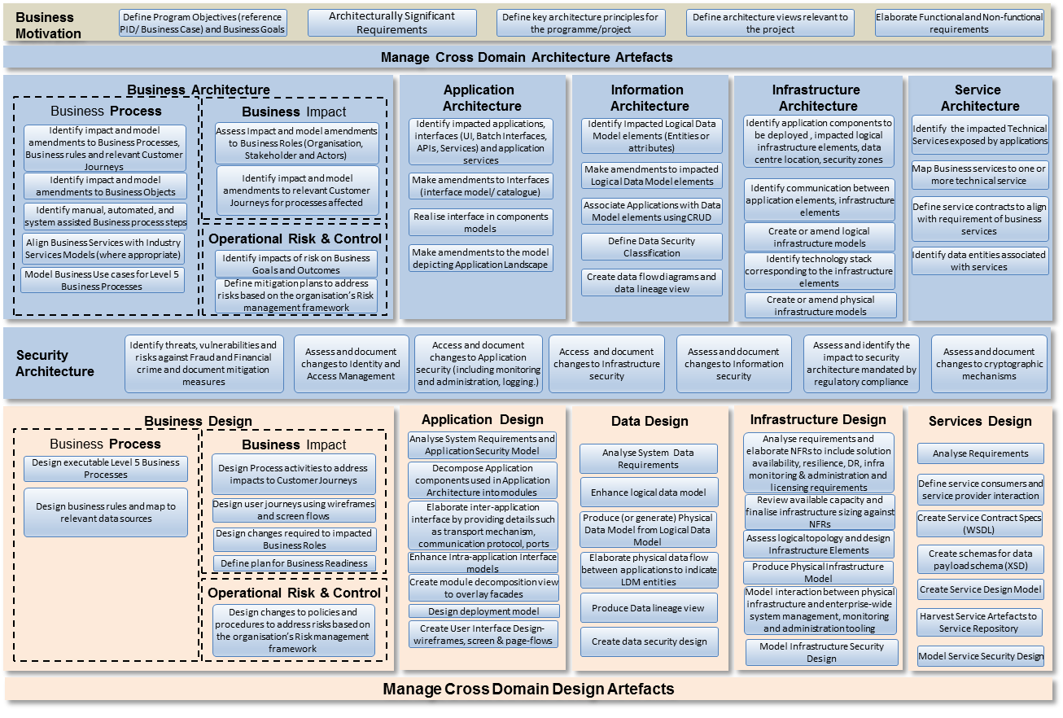
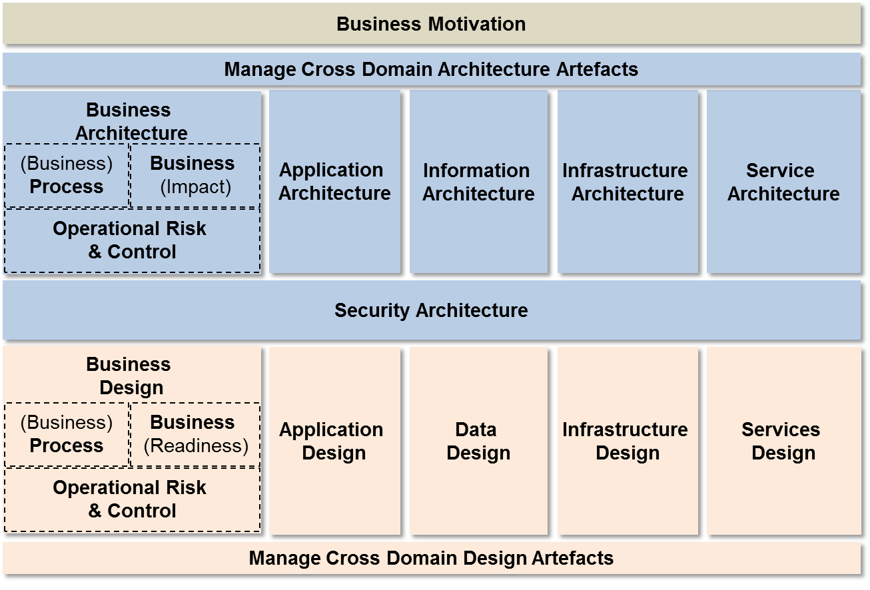
Framework, Method, Method Content
Method (Task View)
The Method is a collective of tasks, the sequence in which they are undertaken, the roles that perform then and the intermediate and final work products that are created in order to meet an agreed objective.
Architecture Description Framework
An Architecture Description Framework establishes a common practice for creating, interpreting, analyzing and using architecture descriptions within a particular domain
Inputs
Project Inputs
Enterprise Continuum
Role
Outputs
Work Products
TASK
TASK STEPS
TASK STEPS
Method Content
Method content describes what is to be produced, the necessary skills required, and the step-by-step explanation describing how specific development goals are achieved. These method content descriptions are independent of a development lifecycle.

Slide 5
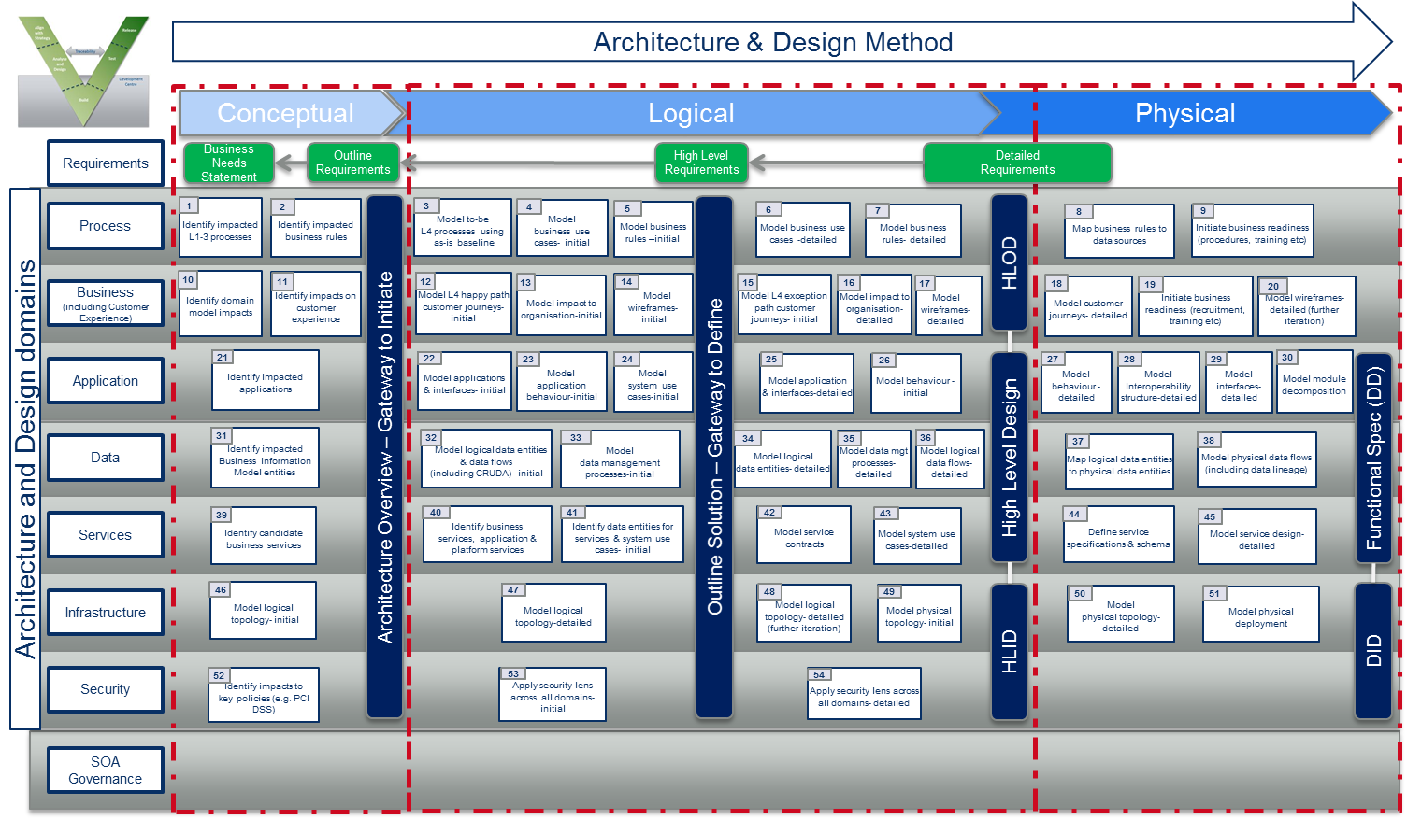
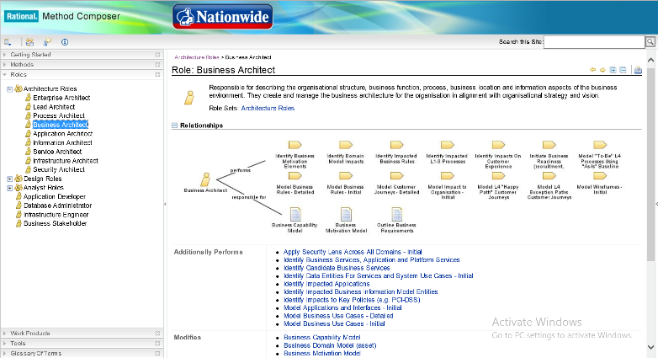
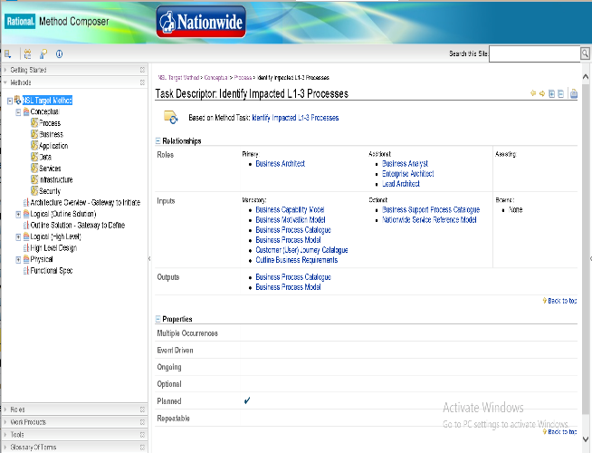

High Level Method Journey Represents the journey undertaken by SLT Wave 3 to define the NSL High Level Method
NSL High Level Method (Complete) in RMC
Business Motivation
Business Architecture
Application
Architecture
Information
Architecture
Infrastructure
Architecture
Service
Architecture
Security Architecture
Application
Design
Data
Design
Infrastructure
Design
Services
Design
CDM Framework
Solution Definition Workshops
NSL High Level Method Flow
Method Content Review
Method Content Review
Task Flow Workshops
Discovery Workshops
NSL High Level Method (Starter) in RMC
The Journey continues to Detail the method in subsequent work packages
Requirements Workshops
NSL Framework

Slide 6
Solution Definition Workshops – Summary of outcomes These outcomes resulted in changes made to arrive at the NSL High Level Method
CHANGES TO CDM
Changes outlined below incorporated into the Method
Tasks added, modified
Work Products added/ updated/ deleted
Flow of tasks defined
Tasks split into conceptual/ logical and Physical
Application
Manage Assets task split into Architecture and design cards
SOA
Alignment with Chase and NEM
ARIS & IBM Process Designer
Business Process (2 workshops)
Risk and Compliance
Business Rules
Level 1-5 Business Processes
Meta model updates
Business Solutions
Addition of Business Design and associated tasks
Hand off to Business Readiness
Infrastructure
Design for Service
Technical Design
Reusability of Assets
Information
Bottom up approach
Data Management Processes
RSA vs IDA
Security
Business Processes and Security Policies alignment
Customer Journeys
Alignment Diagrams

Slide 7
Nationwide’s Target NSL Method Framework Incorporating changes from the 11 Solution Definition Workshops
Business Motivation
Manage Cross Domain Architecture Artefacts
Business
Architecture
Application
Architecture
Information
Architecture
Infrastructure
Architecture
Service
Architecture
(Business)
Process
Business
(Impact)
Operational Risk
& Control
Security Architecture
Business
Design
Application
Design
Data
Design
Infrastructure
Design
Services
Design
(Business)
Process
Business
(Readiness)
Operational Risk
& Control
Manage Cross Domain Design Artefacts

Slide 8
NSL Method: Task View of the Method
Business
Motivation
Define Program Objectives (reference PID/ Business Case) and Business Goals
Architecturally Significant Requirements
Define key architecture principles for the programme/project
Define architecture views relevant to the project
Elaborate Functional and Non-functional requirements
Manage Cross Domain Architecture Artefacts
Business Architecture
Application
Architecture
Information
Architecture
Infrastructure
Architecture
Service
Architecture
Business Process
Business Impact
Identify impact and model amendments to Business Processes, Business rules and relevant Customer Journeys
Assess Impact and model amendments to Business Roles (Organisation, Stakeholder and Actors)
Identify impacted applications, interfaces (UI, Batch Interfaces, APIs, Services) and application services
Identify Impacted Logical Data Model elements (Entities or attributes)
Identify application components to be deployed , impacted logical infrastructure elements, data centre location, security zones
Identify the impacted Technical Services exposed by applications
Identify impact and model amendments to Business Objects
Identify impact and model amendments to relevant Customer Journeys for processes affected
Make amendments to Interfaces (interface model/ catalogue)
Make amendments to impacted Logical Data Model elements
Map Business services to one or more technical service
Associate Applications with Data Model elements using CRUD
Identify communication between application elements, infrastructure elements
Define service contracts to align with requirement of business services
Identify manual, automated, and system assisted Business process steps
Realise interface in components models
Define Data Security Classification
Align Business Services with Industry Services Models (where appropriate)
Operational Risk & Control
Create or amend logical infrastructure models
Identify impacts of risk on Business Goals and Outcomes
Make amendments to the model depicting Application Landscape
Create data flow diagrams and data lineage view
Identify technology stack corresponding to the infrastructure elements
Identify data entities associated with services
Model Business Use cases for Level 4 Business Processes
Define mitigation plans to address risks based on the organisation’s Risk management framework
Identify and model impacts to Data Management Processes
Create or amend physical infrastructure models
Security
Architecture
Identify threats, vulnerabilities and risks against Fraud and Financial crime and document mitigation measures
Assess and document changes to Identity and Access Management
Access and document changes to Application security (including monitoring and administration, logging.)
Access and document changes to Infrastructure security
Assess and document changes to Information security
Assess and document changes to Service security
Assess and identify the impact to security architecture mandated by regulatory compliance
Assess and document changes to cryptographic mechanisms
Business Design
Application Design
Data Design
Infrastructure Design
Services Design
Business Process
Business Impact
Analyse System Requirements and Application Security Model
Analyse System Data Requirements
Analyse requirements and elaborate NFRs to include solution availability, resilience, DR, infra monitoring & administration and licensing requirements
Analyse Service Requirements
Design executable Level 5 Business Processes
Design Process activities to address impacts to Customer Journeys
Decompose Application components used in Application Architecture into modules
Design business rules and map to relevant data sources
Enhance logical data model
Define service consumers and service provider interaction
Design user journeys using wireframes and screen flows
Elaborate inter-application interface by providing details such as transport mechanism, communication protocol, ports
Produce (or generate) Physical Data Model from Logical Data Model
Review available capacity and finalise infrastructure sizing against NFRs
Create Service Contract Specs (WSDL)
Design changes required to impacted Business Roles
Assess logical topology and design Infrastructure Elements
Create schemas for data payload schema (XSD)
Define plan for Business Readiness
Enhance Intra-application Interface models
Elaborate physical data flow between applications to indicate LDM entities
Produce Physical Infrastructure Deployment Model
Operational Risk & Control
Create module decomposition view to overlay facades
Model interaction between physical infrastructure and enterprise-wide system management, monitoring and administration tooling
Create Service Design Model
Design changes to policies and procedures to address risks based on the organisation’s Risk management framework
Design deployment model
Produce Data lineage view
Harvest Service Artefacts to Service Repository
Create User Interface Design- wireframes, screen & page-flows
Create data security design
Model detailed changes to Data Management Processes
Model Infrastructure Security Design
Model Service Security Design
Manage Cross Domain Design Artefacts

Slide 9
Mapping NSL Method Tasks to the CDM Method Tasks
C / L / P | Domain | Night Ref | Task | NSL Method Reference | Method Ref
C | Process & Services | 1 | Identify impacted L1-3 processes | Identify impact and model amendments to Business Processes, Business rules and relevant Customer Journeys Align Business Services with Industry Services Models (where appropriate)
C | Process | 2 | Identify impacted business rules | Identify impact and model amendments to Business Processes, Business rules and relevant Customer Journeys
L | Process | 3 | Model to-be L4 processes using as-is baseline | Identify manual, automated, and system assisted Business process steps
L | Process | 4 | Model business use cases - initial | Model Business Use cases for Level 4 Business Processes
L | Process | 5 | Model business rules - intial | Identify impact and model amendments to Business Processes, Business rules and relevant Customer Journeys
L | Process | 6 | Model business use cases - detailed | Model Business Use cases for Level 4 Business Processes
L | Process | 7 | Model business rules - detailed | Identify impact and model amendments to Business Processes, Business rules and relevant Customer Journeys
L | Process | 8 | Model L5 processes (manual & system assist) | Design executable Level 5 Business Processes
P | Process | 9 | Map business rules to master data sources | Design business rules and map to relevant data sources
P | Process | 10 | Initiate business readiness (procedures, training materials etc.) | Define plan for Business Readiness
P | Process | 11 | Detailed process design - impact on SLA / elapsed time | Design executable Level 5 Business Processes
C | Business | 12 | Identify domain model impacts | Assess Impact and model amendments to Business Roles (Organisation, Stakeholder and Actors)
C | Business | 13 | Identify impacts on customer experience | Identify impact and model amendments to relevant Customer Journeys for processes affected
L | Business | 14 | Model L4 happy path customer journeys - initial | Identify impact and model amendments to relevant Customer Journeys for processes affected
L | Business | 15 | Model impact to organisation - initial | Assess Impact and model amendments to Business Roles (Organisation, Stakeholder and Actors)
L | Business | 16 | Model wireframes - initial | Identify impact and model amendments to relevant Customer Journeys for processes affected
L | Business | 17 | Model exception path customer journeys - initial | Identify impact and model amendments to relevant Customer Journeys for processes affected
L | Business | 18 | Model impact to organisation - detailed | Design changes required to impacted Business Roles
L | Business | 19 | Model wireframes - detailed | Design user journeys using wireframes and screen flows
P | Business | 20 | Model customer journeys - detailed | Design Process activities to address impacts to Customer Journeys
P | Business | 21 | Initiate business readiness (recruitment, training need etc.) | Define plan for Business Readiness
P | Business | 22 | Model wireframes - detailed (further iteration) | Design user journeys using wireframes and screen flows Create User Interface Design- wireframes, screen & page-flows

Slide 10
Mapping NSL Method Tasks to the CDM Method Tasks (Contd.)
C / L / P | Domain | Night Ref | Task | NSL Method Reference | Method Ref
C | Application | 23 | Identify impact on applications | Identify impacted applications, interfaces (UI, Batch Interfaces, APIs, Services) and application services Make amendments to the model depicting Application Landscape
L | Application | 24 | Model applications & interfaces - initial | Identify impacted applications, interfaces (UI, Batch Interfaces, APIs, Services) and application services
L | Application | 25 | Model application behaviour - initial | Identify impacted applications, interfaces (UI, Batch Interfaces, APIs, Services) and application services
L | Application | 26 | Model system use cases - initial | Identify impacted applications, interfaces (UI, Batch Interfaces, APIs, Services) and application services
L | Application | 27 | Model application & interfaces - detailed | Make amendments to Interfaces (interface model/ catalogue) Enhance Intra-application Interface models
L | Application | 28 | Model behaviour - initial | Identify impacted applications, interfaces (UI, Batch Interfaces, APIs, Services) and application services
L | Application | 29 | Model system use cases - detailed | Make amendments to Interfaces (interface model/ catalogue)
P | Application | 30 | Model behaviour - detailed | Elaborate inter-application interface by providing details such as transport mechanism, communication protocol, ports
P | Application | 31 | Model Inter-operability detailed (TBC) | Elaborate inter-application interface by providing details such as transport mechanism, communication protocol, ports
P | Application | 32 | Model interfaces - detailed | Elaborate inter-application interface by providing details such as transport mechanism, communication protocol, ports
P | Application | 33 | Model module decomposition | Decompose Application components used in Application Architecture into modules Create module decomposition view to overlay facades Design deployment model
C | Data | 34 | Identify impacted Business Information Model entities | Identify impact and model amendments to Business Objects
L | Data | 35 | Model logical data entities & flows (including CRUDA) - initial | Identify Impacted Logical Data Model elements (Entities or attributes) Associate Applications with Data Model elements using CRUD
L | Data | 36 | Model data management processes - initial | Identify and model impacts to Data Management Processes
L | Data | 37 | Model logical data entities - detailed | Make amendments to impacted Logical Data Model elements Define Data Security Classification
L | Data | 38 | Model data management processes - detailed | Identify and model impacts to Data Management Processes
L | Data | 39 | Model logical data flows - detailed | Create data flow diagrams and data lineage view
L | Data | 40 | Map business to technical logical models | Make amendments to impacted Logical Data Model elements Enhance logical data model
P | Data | 41 | Map logical data to physical data | Analyse System Data Requirements Produce (or generate) Physical Data Model from Logical Data Model Create data security design
P | Data | 42 | Model physical data flows (including data lineage) | Elaborate physical data flow between applications to indicate LDM entities Produce Data lineage view
P | Data | 43 | Model data management processes - detailed (further iteration) | Model detailed changes to Data Management Processes

Slide 11
Mapping NSL Method Tasks to the CDM Method Tasks (Contd.)
C / L / P | Domain | Night Ref | Task | NSL Method Reference | Method Ref
C | Services | 44 | Identify impact on business services | Identify manual, automated, and system assisted Business process steps Align Business Services with Industry Services Models (where appropriate)
L | Services | 45 | Identify business services, application & platform services | Identify the impacted Technical Services exposed by applications
L | Services | 46 | Identify data entities for services & system use cases - initial | Identify data entities associated with services
L | Services | 47 | Model service contracts | Define service contracts to align with requirement of business services
L | Services | 48 | Identify data entities for services & system use cases - detailed | Identify data entities associated with services
P | Services | 49 | Define service specifications & schema | Analyse Service Requirements Define service consumers and service provider interaction
P | Services | 50 | Model service design - detailed | Create Service Contract Specs (WSDL) Create schemas for data payload schema (XSD) Create Service Design Model Harvest Service Artefacts to Service Repository
C | Infrastructure | 51 | Identify impact on infrastructure | Identify Impacted Logical Data Model elements (Entities or attributes)
L | Infrastructure | 52 | Model logical topology - initial | Create or amend logical infrastructure models
L | Infrastructure | 53 | Model logical topology - detailed | Identify communication between application elements, infrastructure elements Assess logical topology and design Infrastructure Elements
L | Infrastructure | 54 | Model physical topology - initial | Identify technology stack corresponding to the infrastructure elements Create or amend physical infrastructure models Model Infrastructure Security Design
P | Infrastructure | 55 | Model physical topology - detailed | Analyse requirements and elaborate NFRs to include solution availability, resilience, DR, infra monitoring & administration and licensing requirements Review available capacity and finalise infrastructure sizing against NFRs Model interaction between physical infrastructure and enterprise-wide system management, monitoring and administration tooling
P | Infrastructure | 56 | Model physical deployment | Produce Physical Infrastructure Deployment Model

Slide 12
Mapping NSL Method Tasks to the CDM Method Tasks (Contd.)
C / L / P | Domain | Night Ref | Task | NSL Method Reference | Method Ref
C | Security | 57 | Identify impacts to key policies (e.g. PCI DSS) | Identify threats, vulnerabilities and risks against Fraud and Financial crime and document mitigation measures
L | Security | 58 | Apply security lens across all domains - initial | Assess and document changes to Identity and Access Management Access and document changes to Application security (including monitoring and administration, logging.) Access and document changes to Infrastructure security Assess and document changes to Information security Assess and document changes to Service security
L | Security | 59 | Apply security lens across all domains - detailed | Assess and document changes to Identity and Access Management Access and document changes to Application security (including monitoring and administration, logging.) Access and document changes to Infrastructure security Assess and document changes to Information security Assess and document changes to Service security Assess and identify the impact to security architecture mandated by regulatory compliance
P | Security | 60 | Apply security lens across all domains - detailed (further iteration) | Assess and document changes to Identity and Access Management Access and document changes to Application security (including monitoring and administration, logging.) Access and document changes to Infrastructure security Assess and document changes to Information security Assess and identify the impact to security architecture mandated by regulatory compliance Assess and document changes to cryptographic mechanisms
L | Op Risk & Control | 61 | Identify impacts of change on operational risks - initial | Identify impacts of risk on Business Goals and Outcomes
L | Op Risk & Control | 62 | Identify impacts of change on operational risks - detailed | Define mitigation plans to address risks based on the organisation’s Risk management framework
P | Op Risk & Control | 63 | Identify impacts of change on operational risks - detailed (further iteration) | Design changes to policies and procedures to address risks based on the organisation’s Risk management framework

Slide 13
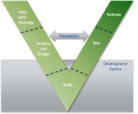
Sequence of tasks in the Method (Baseline) – Domains and Conceptual, Logical, Physical Separation of Tasks
Architecture & Design Method
Detailed
Requirements
High Level Requirements
Conceptual
Logical
Physical
Business Needs Statement
Outline Requirements
Requirements
1
Architecture Overview – Gateway to Initiate
Outline Solution – Gateway to Define
Identify impacted L1-3 processes
2
3
4
DOD
Identify impacted business rules
Model to-be
L4 processes using
as-is baseline
Model
business use
cases- initial
5
HLOD
Model business rules–initial
6
Process
Model business use cases -detailed
7
10
Model business
rules-detailed
8
9
11
Model L5 processes (manual & system assist)
Map business rules to master data source
Initiate business readiness (procedures, training material etc)
Detailed process design- impact on SLA/elapsed time
12
Identify domain model impacts
Identify impacts on customer
experience
Model happy path & known exception customer journeys
13
14
15
Model wireframes-
initial
17
18
Model impact to organisation-initial
16
Model exception
path customer journeys
Model impact to organisation- detailed
19
20
Model wireframes- detailed
Model customer journeys-detailed
21
Initiate business
readiness (recruitment, training needs etc)
Model wireframes-detailed (further iteration)
Business
(including Customer Experience)
22
Identify impact on applications
23
33
Model applications
& interfaces-initial
25
26
30
Model Interoperability–detailed [TBC]
32
Model module decomposition
24
Model
application behaviour-initial
Model
system use cases-initial
27
28
High Level Design
Model behaviour-detailed
31
Model interfaces-detailed
Functional Spec (DD)
Model application & interfaces-detailed
Model behaviour-initial
29
Application
Model system use cases-detailed
Identify impacted Business Information Model entities
34
Map bus to tech logical models
35
39
40
Model data mgt processes-detailed (further iteration)
Model logical data entities
& data flows
(including CRUDA)-initial
36
37
Model data mgt processes-detailed
Model logical
data flows-
detailed
43
Model
data management processes-initial
Model logical
data entities- detailed
38
Map logical data to physical data
42
Data
41
Model physical data
flows (including data lineage)
Architecture and Design domains
Model service contracts
Model service design- detailed
45
46
47
49
50
44
Identify business
services, application & platform services
Identify data entities for services & system use cases-initial
48
Define service specifications & schema
Services
Identify impact on business services
Identify data entities for services & system use cases-detailed
Identify impact on infrastructure
51
52
HLID
DID
Model logical
topology-initial
53
Model logical
topology-detailed
Model physical topology-initial
54
55
Model
physical topology-detailed
56
Infrastructure
Model physical deployment
Apply security lens across all domains-detailed
(further iteration)
Security
Identify impact of
key policies (e.g. PCI DSS)
58
Apply security lens across all domains-detailed
60
57
Apply security lens across all domains-initial
59
Identify impacts of change on operational risks-initial
62
61
Identify impacts of change on operational risks-detailed
Identify impacts of change on operational risks – detailed (further iteration)
Op Risk & Control
63
Note: Definitions of these tasks along with inputs, outputs and roles is in
The documented method in Rational Method Composer
Night Sky v1.1

Slide 14
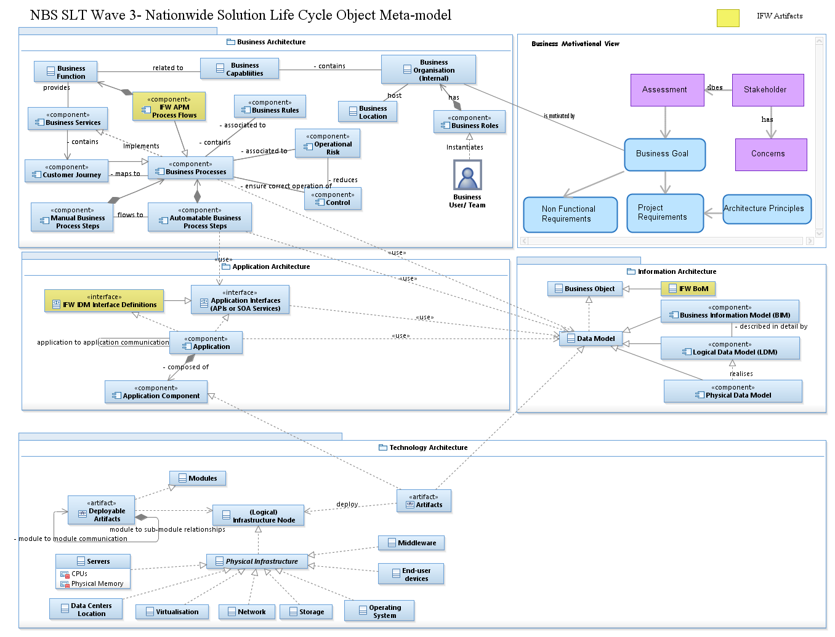
The NSL Method Object Meta Model
The Object Metamodel highlights the key elements of the Architecture and Design lifecycle and their relationships.

Slide 15
Meta Model Entities Description
Metamodel Entity | Description | Reference
Business User/Team | A person or team within the organisation that has a role that initiates or interacts with activities; for example, a sales representative who travels to visit customers or debt collection team who collect the debt from customers. | Togaf Content Metamodel
Business Roles | The usual or expected function of a business user or the part somebody or something plays in a particular action or event. An business user may have a number of roles. | Togaf Content Metamodel
Business Organisation | A self-contained unit of resources with goals, objectives, and measures. Business Organisation (or Organisation units) may include external parties and business partner organisations. | Togaf Content Metamodel
Business Location | A place where business activity takes place and can be hierarchically decomposed. | Togaf Content Metamodel
Business Capabilities | A business-focused outcome that is delivered by the completion of one or more work packages. Using a capability-based planning approach, change activities can be sequenced and grouped in order to provide continuous and incremental business value. | Togaf Content Metamodel
Business Function | Delivers business capabilities closely aligned to an organisation, but not necessarily explicitly governed by the organisation. Also referred to as "business function". | Togaf Content Metamodel
Business Services | Supports business capabilities through an explicitly defined interface and is explicitly governed by an organisation. | Togaf Content Metamodel
IFW APM Process Flows | IFW Analysis Process Model (APM) Process flows provide banking business processes content to address areas such as business process reengineering | IBM IFW
Customer Journey | Customer journeys are the step by step activities that a customer experiences to reach their goal. | RMC
Business Process | A process represents flow of control between or within functions and/or services (depends on the granularity of definition). Business Processes represent a sequence of activities that together achieve a specified outcome, can be decomposed into sub-processes, and can show operation of a function or service (at next level of detail). Processes may also be used to link or compose organizations, functions, services, and processes. | Togaf Content Metamodel
Manual Business Process Steps | The steps that are involved in a business process though performed manually by a human actor. This also includes the manual part of a system assisted process.
Automatable Business Process Steps | The steps that are involved in a business process and performed automatically by a system or collection of systems. These also include the automatable part of a system assisted process.
Business Rules | It is a rule that defines or constrains some aspect of business and always resolves to either true or false. Business rules are intended to assert business structure or to control or influence the behavior of the business. | Business Rules Group
Operational Risk | Its is "the risk of a change in value caused by the fact that actual losses, incurred for inadequate or failed internal processes, people and systems, or from external events (including legal risk), differ from the expected losses". | Basel II
Control | A decision-making step with accompanying decision logic used to determine execution approach for a process or to ensure that a process complies with governance criteria. For example, a sign-off control on the purchase request processing process that checks whether the total value of the request is within the sign-off limits of the requester, or whether it needs escalating to higher authority. | Togaf Content Metamodel
IFW IDM Interface Definitions | IFW Interface Definition Model (IDM) provide business services descriptions | IBM IFW

Slide 16
Meta Model Entities Description (Contd.)
Metamodel Entity | Description | Reference
Application Interfaces (APIs or SOA) | Application interfaces allow exchange of data between application components | Togaf Content Metamodel
Application | An application is a logical representation of a system that enables one or more business capabilities | Togaf Content Metamodel
Application Component | An encapsulation of application functionality aligned to implementation structure. For example, a loan processing application. | Togaf Content Metamodel
Business Object | An encapsulation of data that is recognised by a business domain expert as a thing. | Togaf Content Metamodel
IFW BoM | IFW Business Object Model (BOM) provides banking data content to address areas such as enterprise-wide view of information | IBM IFW
Data Model | Data Model supports the development of information systems by providing the definition and format of data.
Business Information Model (BIM) | BIM is conceptual data model, it is a specialised form of Data Model, hence shares generalisation relation with Data Model.
Logical Data Model (LDM) | Logical data model, is a specialised form of Data Model that elaborate the conceptual data model and shares generalisation relation with Data Model.
Physical Data Model | Physical data model, it is a specialised form of Data Model that shares generalisation relation with Data Model. It is a representation of a data design which takes into account of the facilities and constraints of a given database management system.
Infrastructure Node (Logical) | A node is defined as a computational resource upon which artifacts may be stored or deployed for execution. | Archimate
Physical Infrastructure | The Physical Infrastructure is the environment to support the growing interdependency between IT systems and business applications. This includes network design and management strategies and support more demanding service level requirements
Artefacts | A logical or physical element of an asset. A logical asset is a container of at least one physical artefact. Physical artefacts correspond to a file on a file system and represent a workspace product | Reuse Strategy
Middleware | Infrastructure Component
End-user devices | Infrastructure Component
Operating System | Infrastructure Component
Storage | Infrastructure Component
Network | Infrastructure Component
Virtualisation | Infrastructure Component
Data Centers Location | A data centre is a dedicated space where companies can keep and operate most of the ICT infrastructure that supports their business. This would be the servers and storage equipment that run application software and process and store data and content. The location where the data centre is built varies from in-house to an external facility located strategically to safeguard it from normal natural disasters and forces of nature.
Servers | Infrastructure Component
Deployable Artifacts | Application modules packaged as artefacts that are installable on a designated infrastructure component
Modules | A modular application is an application that is divided into a set of loosely coupled functional units (named modules) that can be integrated into a larger application | MDN

Slide 17
Meta Model Entities Description (Contd.)
Metamodel Entity | Description | Reference
Stakeholder | Stakeholders are individuals, groups or organizations holding Concerns for the System of Interest. Examples of stakeholders: client, owner, user, consumer, supplier, designer, maintainer, auditor, CEO, certification authority, architect. | http://www.iso-architecture.org/ieee-1471/cm/
Concerns | A Concern is any interest in the system. The term derives from the phrase “separation of concerns” as originally coined by Edsgar Dijkstra. Examples of concerns: (system) purpose, functionality, structure, behavior, cost, supportability, safety, interoperability. | http://www.iso-architecture.org/ieee-1471/cm/
Assessment | A Business Assessment is designed to provide an objective view of your business, financially and operationally.
Business Goal | A high-level statement of intent or direction for an organisation. Typically used to measure success of an organisation. | Togaf Content Metamodel
Non Functional Requirements | The non-functional requirement elaborates a performance characteristic required of the system.
Project Requirement | The Project Requirements documents the operations and activities that a system must be able to perform.
Architecture Principle | A qualitative statement of intent that should be met by the architecture and has at least a supporting rationale and a measure of importance. | Togaf Content Metamodel

Slide 18
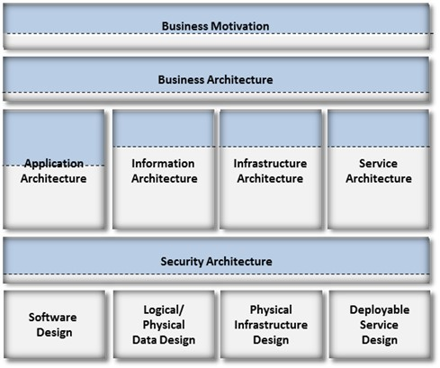
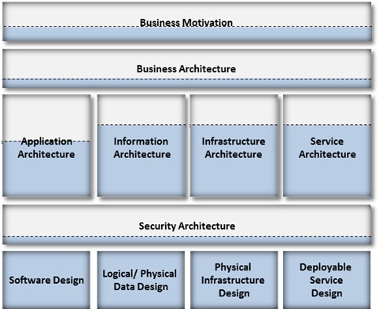
N-pass Model (2-pass shown as an illustration)
The Defender Method iteratively builds the solution architecture and design. These iterations result in deliverables which align with the needs of most organisations to determine a high level estimate of cost, timeline and risk of a project (Financial Checkpoints) before proceeding to detailed definitions. They further align with defined Architecture and Design gates to confirm the solution conforms with architecture/design principles and standards while enabling strategic building blocks of the Organisation’s target architecture. Although a 2-pass model is shown, the number of passes would vary with each Organisation.
Pass 2 elaborates the models and artefacts created during Pass 1 addressing all functional and non functional requirements and completes the remainder of the lifecycle up to Design being completed.
This approach avoids rework, and wasted effort as all Pass 1 artefacts are evolved to produce the final artefacts.
The focus of Pass 1 is to elicit and address architecturally significant requirements to a level where the impact on various architectural elements are identified and assessed. It provides adequate detail to estimate a high level view of complexity, cost and time required to realise the programme objectives.
Iterative
Iterative
Application
Design
Application
Design
Design Gate
Financial Gate
Project Lifecycle
Overview Models
PASS 1
Alignment to Architecture/Design Principles, Patterns & Standards
High level estimate of
cost, timeline and complexity
Detail Models
PASS 2
Illustrated how much of the task is completed in each domain for a PASS

Slide 19
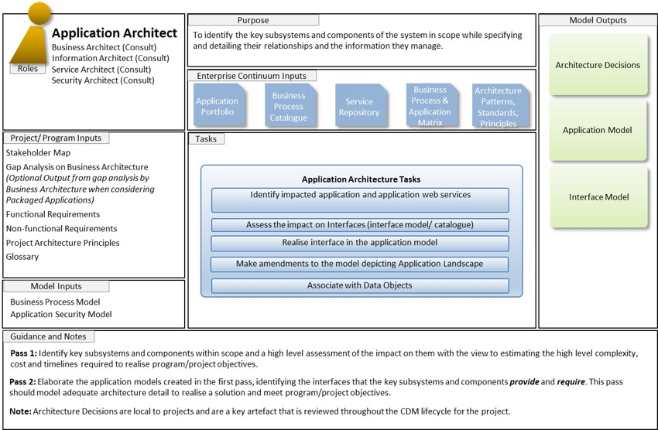
How to read a task card
Roles:
Roles that are involved in this task card are listed.
The Role in BOLD is the primary role responsible for this overall task card. The ‘Consult’ are roles that play a part in delivering the tasks and outcomes listed as part of the Method Outputs. However the task card does not specify which roles come together to complete each of the tasks and which outcomes are delivered as a result.
Purpose:
Brief description of the purpose of this task card in its entirety.
Enterprise Continuum Inputs:
List of inputs that represent architecture and design assets from a reusable source that help progress the quality of the solution and improve the productivity of the design effort.
Method Outputs:
List of Architecture Artefacts created. These artefacts are iteratively elaborated as necessary to describe the architecture and design in more detail. These Method Outputs may become Method inputs in subsequent task cards.
The Method Outputs will normally be included as part of a larger deliverable required at defined gates of the organisation’s change lifecycle.
Inputs:
Inputs can be either Program/ Project Inputs or Method Inputs that have been delivered by a previous Task Card.
Tasks:
High level task steps that elaborate the Architecture and Design Description to a sufficient level of detail. They provide coverage of the Architecture & Design activities performed by that domain which are practically necessary to deliver the solution in a comprehensive manner.
These high level tasks are further decomposed into activities to cover the necessary work to be undertaken by the primary role of the task card.
Guidance and Notes:
CDM approaches the description of Architecture and design as an iterative process. The concept of passes of the Method adds sufficient Architecture and design detail through every pass as is necessary to feed into defined Project Gates for estimation and feasibility analysis. The number of passes is determined by the organisation. Tasks are split either completely or partially at each pass depending on availability of information and clarity of requirements.

Slide 20
Business Motivation
Business Architect
Enterprise Architect (Consult)
Business Stakeholders (Consult)
Business Analyst (accountable for functional/ non-functional requirements)
Purpose
Outputs
The motivation extension is intended to allow additional structured modeling of the drivers, goals, and objectives that influence an organisation to provide business services to its customers.
Business Motivation Model
Roles
Enterprise Continuum Inputs
Architecture Continuum
Architecture Patterns
Architecture Principles
Program Objectives
& Goals
Stakeholder Concerns
Business Drivers
Business Strategy
Project Portfolio
Program Initiation Document/ Business Case
Project Architecture Principles
Project/ Program Inputs
Tasks
Document Business Motivation
Define Program Objectives (reference PID/ Business Case) and Business Goals
Project Architecture
Views
Identify architecturally significant requirements
Define key architecture principles for the programme/project
Functional Requirements (Project)
Define project relevant views catalogue
Elaborate Functional and Non-functional requirements
Non Functional Requirements (Project)
Guidance and Notes
Pass 1: Start with defining program objectives and business goals that should drive requirements (both functional and non-functional). Based on the requirements assess the impacted architecture aspect areas (application, information, infra etc.). Based on the impact on the architecture aspect area define views that are relevant to the project and stakeholders’ expectations.
Pass 2: You may want to revisit this phase to elaborate functional and non-functional requirements.
“Architecturally significant requirements are a subset of the requirements that need to be satisfied before the architecture can be considered "stable". Typically, these are requirements that are technically challenging, technically constraining, or central to the system's purpose. These requirements also have a material bearing on the cost and timeline required to meet program objectives.” – courtesy Integrated Architecture Framework

Slide 21
Business Architecture (Business)
Business Architect
Process Architect (Consult)
Enterprise Architect (Consult)
Application Architect (Consult)
Information Architect (Consult)
Service Architect (Consult)
Security Architect (Consult)
Purpose
Outputs
To identify the impact of changes to the architecture on the Business’s ability to fulfil the Business Strategy and Drivers.
Business Process Model
(Impacted Business Processes)
Roles
Enterprise Continuum Inputs
Role Catalogue
Business Services Catalogue
Business Process Catalogue
Organisational Model
Architecture Principles
Industry
Services
Model(s)
Customer Journey Model
Program Objectives & Goals
Functional Requirements
Non-functional Requirements
Project Architecture Principles
Project Architecture Views
Business Drivers
Stakeholder Map
Glossary
Organisation-Actor Catalogue
Project/ Program Inputs
Tasks
Business Architecture Tasks (Business)
Assess Impact and model amendments to Business Roles (Organisation, Stakeholder and Actors)
Business Service Catalogue
Identify impact and model amendments to relevant Customer Journeys
Identify impact and model amendments to Business Objects (Conceptual Information Model)
Conceptual Information Model
Identify manual and automatable Business process steps
Business Motivation Model
Role Catalogue
(Impacted Business Roles)
Model Inputs
Guidance and Notes
Pass 1: Identify the impacts to Customer Journeys, Business Roles, associated business processes and objects. Model the impacted Customer Journeys.
Pass 2: Model the changes to Business Role to accommodate new ways of working while addressing impacts to customer experience. Detail the impacts to Business objects and address the impacts of those changes on business integration points.

Slide 22
Business Architecture (Process)
Business Architect
Process Architect (Consult)
Enterprise Architect (Consult)
Application Architect (Consult)
Information Architect (Consult)
Service Architect (Consult)
Security Architect (Consult)
Purpose
Outputs
To identify the impact and required architectural changes on the people, processes, services and technology to fulfil the Business Strategy and Drivers.
Business Process Model
(Impacted Business Processes)
Roles
Enterprise Continuum Inputs
Role Catalogue
Business Services Catalogue
Business Process Catalogue
Organisational Model
Architecture Principles
Industry
Services
Model(s)
Business Service Catalogue
Program Objectives & Goals
Functional Requirements
Non-functional Requirements
Project Architecture Principles
Project Architecture Views
Business Drivers
Stakeholder Map
Glossary
Project/ Program Inputs
Tasks
Business Architecture Tasks (Process)
Conceptual Information Model
Identify impact and model amendments to Business Processes and Business Rules
Identify impact and model amendments to Business Objects (Conceptual Information Model)
Role Catalogue
(Impacted Business Roles)
Identify manual, automated and system assisted Business activities
Align Business Services with Industry Services Models (where appropriate)
Business Motivation Model
Business Rules Catalogue
Model Inputs
Model Business Use cases for Level 4 Business Processes
Guidance and Notes
Pass 1: Identify the impacts to Business processes, objects and services. Model the impacted Business Processes as well as the manual, system-assisted and automatable business activities.
Pass 2: Model the changes to Business Processes to accommodate new ways of working. Detail the impacts to Business objects and address the impacts of those changes on business integration points. Align the Business Services against Industry Services Models (where appropriate)

Slide 23
Application Architecture
Application Architect
Business Architect (Consult)
Information Architect (Consult)
Service Architect (Consult)
Security Architect (Consult)
Purpose
Model Outputs
To identify the key subsystems and components of the system in scope while specifying and detailing their relationships and the information they manage.
Architecture Decisions
Roles
Enterprise Continuum Inputs
Application Portfolio
Business Process Catalogue
Service Repository
Business Process & Application Matrix
Architecture Patterns, Standards, Principles
Application Model
Stakeholder Map
Gap Analysis on Business Architecture (Optional Output from gap analysis by Business Architecture when considering Packaged Applications)
Functional Requirements
Non-functional Requirements
Project Architecture Principles
Glossary
Project/ Program Inputs
Tasks
Application Architecture Tasks
Interface Model
Identify impacted application and application web services
Assess the impact on Interfaces (interface model/ catalogue)
Realise interface in the application model
Make amendments to the model depicting Application Landscape
Business Process Model
Application Security Model
Associate with Data Objects
Model Inputs
Guidance and Notes
Pass 1: Identify key subsystems and components within scope and a high level assessment of the impact on them with the view to estimating the high level complexity, cost and timelines required to realise program/project objectives.
Pass 2: Elaborate the application models created in the first pass, identifying the interfaces that the key subsystems and components provide and require. This pass should model adequate architecture detail to realise a solution and meet program/project objectives.
Note: Architecture Decisions are local to projects and are a key artefact that is reviewed throughout the CDM lifecycle for the project.

Slide 24
Information Architecture
Information Architect
Business Architect (Consult)
Application Architect (Consult)
Security Architect (Consult)
Service Architect (Consult)
Purpose
Model Outputs
To identify and detail the information architecture elements This activity also ensures alignment of the solutions with the Information Strategy defined for the organisation.
Logical Data Model
Roles
Enterprise Continuum Inputs
Business Object Model
Data meta-Model
Data Entity Catalogue
Industry Models
Enterprise Information Principles
Data Flow Diagram
Architecture Decisions
Stakeholder Map
Functional Requirements
Non Functional Requirements
Project Architecture Principles
Glossary
Project/ Program Inputs
Tasks
Information Architecture Tasks
Data Application Interaction Diagram
Identify Impacted Logical Data Model elements (Entities or attributes)
Make amendments to impacted Logical Data Model elements
Associate Applications with Data Model elements using CRUD
Data Lineage View
Define Data Security Classification
Model Inputs
Business Process Model
Application Model
Information Security Model
Create data flow diagrams and data lineage view
Guidance and Notes
Pass 1: This pass results in the identification of the impacted information architecture elements and defines the Logical Data Model.
Pass 2: Determine any new entities or attributes are required, existing entities or attributes are to be removed, or existing entities or attributes are to be changed. Consider the inter-entity and make the changes required. Model the Data Application Interactions, Data Flows and Data Lineage.

Slide 25
Infrastructure Architecture
Infrastructure Architect
Application Architect (Consult)
Information Architect (Consult)
Security Architect (Consult)
Purpose
Model Outputs
Identify the changes to infrastructure landscape by the project to satisfy non-functional and functional requirements.
Logical Infrastructure Model
T
Roles
Enterprise Continuum Inputs
Infrastructure Services Catalogue
Infrastructure Reference Model
Architecture Principles
Infrastructure Standards and Patterns
T
Physical Infrastructure Model
Architecture Decisions
Stakeholder Map
Functional Requirements
Non-functional Requirements
Project Architecture Principles
Glossary
Project/ Program Inputs
Tasks
Infrastructure Architecture Tasks
Identify application components to be deployed , impacted logical infrastructure elements, data centre location, security zones
Technology Portfolio Catalogue
Identify communication between application elements, infrastructure elements
Application Model
Logical Data Model
Service Model
Infrastructure Security Topology
Business Process Model (Optional)
Support Model
Create or amend logical infrastructure models
Model Inputs
Support Model
Identify technology stack corresponding to the infrastructure elements
Create or amend physical infrastructure models
Review Support Model requirements
Guidance and Notes
Pass 1: The scope of Pass 1 is on location, security zones, nodes and application hosting (deployment) and communication between them
Pass 2: Elaborates and adds aspects of technology stack, physical communication and data centers
T
Topology Model

Slide 26
Services Architecture
Service Architect
Application Architect (Consult)
Business Architect (Consult)
Information Architect (Consult)
Infrastructure Architect (Consult)
Purpose
Model Outputs
To identify, create and amend Service interfaces that allow access to business functionality provided by applications
Service Specification
Roles
Enterprise Continuum Inputs
Business Services Catalogue
Services Patterns & Standards
Industry SOA Reference Models
Architecture Principles
Technology Standards
Service Portfolio
Service to Data Interaction Diagram
Architecture Decisions
Stakeholder Map
Functional Requirements
Non-functional Requirements
Project Architecture Principles
Glossary
Project/ Program Inputs
Tasks
Services Architecture Tasks
Identify the impacted Business & Technical Services exposed by applications
Map Business services to one or more technical service
Define service contracts to align with requirement of business services
Business Process Model
Business Services Catalogue
Application Model
Logical Data Model
Model Inputs
Identify data entities associated with services
Assess and document changes to services security
Guidance and Notes
Pass 1: This pass identifies the services, their consumers and relationship with the business process steps that depend on them. In addition this pass also identifies any impact on Enterprise Middleware Infrastructure such as Service Buses, Brokers etc..
Pass 2: This pass elaborates service contracts, protocols, their binding with end-points, service composition and co-ordination. It also elaborates the orchestration required within the business processes to use the services effectively. Service development and build teams should be able to use this model to produce deployable service artefacts.

Slide 27
Security Architecture
Security Architect
Application Architect (Consult)
Business Architect (Consult)
Information Architect (Consult)
Infrastructure Architect (Consult)
Purpose
Model Outputs
Define the security aspects of business, application, data, infrastructure and service architectures that are impacted in order to comply with the Security Policies and Principles of the organisation
Threat Model
Roles
Enterprise Continuum Inputs
Application-Security model
Business Services Catalogue
Security Patterns & Standards
Security Policies & Principles
Infrastructure Security topology
Stakeholder Concerns
Business Drivers
Business Strategy
Functional Requirements
Non-functional Requirements
Project Architecture Principles
Glossary
Project/ Program Inputs
Tasks
Security Architecture Tasks
Information security model
Identify threats, vulnerabilities and risks against Fraud and Financial crime and document mitigation measures
Assess and document changes to Identity and Access Management
Access and document changes to Application security (including monitoring and administration, logging etc.)
Model Inputs
Business Process Model
Application Model
Logical Data Model
Logical Infrastructure Topology
Physical Infrastructure Topology
Service Model
Access and document changes to Infrastructure security
Assess and document changes to Information security
Assess and identify the impact to security architecture mandated by regulatory compliance
Assess and document changes to cryptographic mechanisms
Guidance and Notes
Pass 1: This pass creates threat model and documents key implications on application, information and infrastructure security aspects.
Pass 2: Elaborates on the threat model and provides complete view of the impact on application, information and infrastructure security aspects.

Slide 28
Business Design (Business)
Business Architect
Process Architect (Consult)
Enterprise Architect (Consult)
Application Designer(Consult)
Data Designer (Consult)
Security Designer(Consult)
Purpose
Outputs
To identify the impact of changes to the architecture on the Business’s ability to fulfil the Business Strategy and Drivers.
Business Process Model
(Impacted Business Processes)
Roles
Enterprise Continuum Inputs
Role Catalogue
Business Services Catalogue
Business Process Catalogue
Organisational Model
Customer Journey Catalogue
Industry
Services
Model(s)
Customer Journey Model
Program Objectives & Goals
Functional Requirements
Non-functional Requirements
Project Architecture Principles
Project Architecture Views
Business Drivers
Stakeholder Map
Glossary
Organisation-Actor Catalogue
Project/ Program Inputs
Tasks
Business Design Tasks (Business)
Model detailed amendments to relevant Customer Journeys
Business Service Catalogue
Initiate Business Readiness (recruitment, training needs, etc.)
Conceptual Information Model
Model wireframes to depict the placement of the various elements of the user interface and the navigation flows
Business Motivation Model
Customer Journeys
SOPs Catalogue (Business and Support)
Model Inputs
Role Catalogue
(Impacted Business Roles)
Guidance and Notes
Model detailed impacts to Customer Journeys, Business Roles and links to processes.
Model detailed changes to Business Role to accommodate new ways of working while addressing impacts to customer experience. Detail the impacts to Business objects and address the impacts of those changes on business integration points. Address those impacts through recruitment channels, training and re-training needs, etc.

Slide 29
Business Design(Process)
Business Designer
Process Architect (Consult)
Enterprise Architect (Consult)
Application Designer (Consult)
Data Designer (Consult)
Service Designer(Consult)
Security Designer (Consult)
Purpose
Outputs
To identify the impact and required architectural changes on the people, processes, services and technology to fulfil the Business Strategy and Drivers.
Business Process Model
(Impacted Business Processes)
Roles
Enterprise Continuum Inputs
Role Catalogue
Business Services Catalogue
Business Process Catalogue
Organisational Model
Architecture Principles
Industry
Services
Model(s)
Customer Journey Model
Program Objectives & Goals
Functional Requirements
Non-functional Requirements
Project Architecture Principles
Project Architecture Views
Business Drivers
Stakeholder Map
Glossary
Organisation-Actor Catalogue
Project/ Program Inputs
Tasks
Business Design Tasks (Process)
Assess Impact and model amendments to Business Roles (Organisation, Stakeholder and Actors)
Business Service Catalogue
Identify impact and model amendments Customer Journeys
Identify impact and model amendments to Business Objects (Conceptual Information Model)
Conceptual Information Model
Identify manual, automated and system assisted Business activities
Business Motivation Model
Align Business Services with Industry Services Models (where appropriate)
Role Catalogue
(Impacted Business Roles)
Model Inputs
Model Business Use cases for Level 5 Business Processes
Guidance and Notes
Pass 1: Identify the impacts to Customer Journeys, Business Roles, processes, objects and services. Model the impacted Customer Journeys and Business Processes as well as the manual and automatable process steps.
Pass 2: Model the changes to Business Role to accommodate new ways of working while addressing impacts to customer experience. Detail the impacts to Business objects and address the impacts of those changes on business integration points. Align the Business Services against Industry Services Models (where appropriate)

Slide 30
Application Design
Application Designer
Application Architect(Consult)
Application Developer(Consult)
Business Analyst (Consult)
Technical Analyst (Consult)
User Experience Analyst(Consult)
Purpose
Model Outputs
To produce application design specifications that help application development teams to implement functional & non functional requirements, using a set of identified components and complying to applicable constraints.
Detailed Module Decomposition Model
Roles
Enterprise Continuum Inputs
Application Portfolio
Design Patterns
Design Principles
Design Standards
Application Deployment Pattern
Inter and Intra Application Communication Diagram
Project/ Program Inputs
Stakeholder Map
Detailed Functional requirements,
Detailed Non Functional requirements
Architecture Decisions
Project Design Principles
Tasks
Application Design Tasks
Detailed Behavioural (Sequence Diagram & Activity Diagram) Models
Analyse System Requirements and Application Security Model
Decompose Application components used in Application Architecture into modules
Create module decomposition view to enable facades (UML Interfaces) to be defined to access the module
Detailed Interface Model
Elaborate inter-application interface by providing details such as transport mechanism, communication protocol, ports etc.
Design deployment model
Class Diagram
Application Model
Application View
Interface Model
Threat Model
Application Security Model
Model Inputs
Create User Interface Design- wireframes, screen & page-flows
Enhance Intra-application Interface models
Guidance and Notes
Application architecture and design models will be baselined after the outputs of this phase are approved by relevant governance bodies and then submitted to the Architecture & Design Reuse Governance forum to harvest these models into the reuse repository.
The views developed for the purpose of the project will also be harvested into project reuse repository.

Slide 31
Data Design
Data Designer
Database Administrator (Consult)
Application Designer (Consult)
Information Architect (Consult)
Technical Analyst (Consult)
Data Analyst (Consult)
Purpose
Model Outputs
To define how data will be consumed, modified and distributed by the solution, provide definition of physical data elements and manage data integrity
Detailed Logical Data model
Roles
Enterprise Continuum Inputs
Business Object Model
Data Design Patterns & Standards
Design Principles
Technology Standards
Physical Data model
Project/ Program Inputs
Stakeholder Map
Detailed Functional requirements,
Detailed Non Functional requirements
Project Design Principles
Tasks
Data Design Tasks
Data Lineage View
Analyse System Data Requirements
Enhance logical data model
Elaborate physical data flow between applications to indicate LDM entities
Application Model
Logical Data Model
Data Flow Diagram
Data Application Interaction Diagram
Threat Model
Information Security Model
Data Lineage View
Model Inputs
Produce (or generate) Physical Data Model from Logical Data Model
Produce Data lineage view
Create data security design
Guidance and Notes
Data architecture and design models will be baselined after the outputs of this phase are approved by relevant governance bodies and then submitted to the Architecture & Design Reuse Governance forum to harvest these models into the reuse repository.
The views developed for the purpose of the project will also be harvested into project reuse repository.

Slide 32
Infrastructure Design
Infrastructure Designer
Infrastructure Architect (Consult)
Infrastructure Engineer (Consult)
Application Designer (Consult)
Data Designer (Consult)
Service Designer (Consult)
Purpose
Model Outputs
To define the physical infrastructure design for all relevant environments such that it meets Non Functional Requirements and integrates with Enterprise capability for Infrastructure Monitoring and Administration
Detailed Physical Infrastructure Model
Roles
Enterprise Continuum Inputs
Infrastructure Design Patterns & Standards
Design Principles
Infrastructure Landscape Model
Monitoring and Administration Model
Project/ Program Inputs
Stakeholder Map
Detailed Functional requirements
Detailed Non Functional requirements
Project Design Principles
Tasks
Infrastructure Design Tasks
Analyse requirements and elaborate NFRs to include solution availability, resilience, DR, infra monitoring & administration and licensing requirements to meet project and Support Model requirements
Environment Promotional Model
Review available capacity and finalise infrastructure sizing against NFRs
Infrastructure Bill Of Material
Application Model
Interface Model
Logical Data Model
Logical Infrastructure Model
Physical Infrastructure Model
Information Security Model
Infrastructure Security Topology
Support Model
Assess logical topology and design Infrastructure Elements
Model Inputs
Produce Physical Infrastructure Deployment Model
Infrastructure Capacity & Sizing
Model interaction between physical infrastructure and enterprise-wide system management, monitoring and administration tooling
Model Infrastructure Security Design
Support Model
Guidance and Notes
Infrastructure architecture and design models will be baselined after the outputs of this phase are approved by relevant governance bodies and then submitted to the Architecture & Design Reuse Governance forum to harvest these models into the reuse repository.
The views developed for the purpose of the project will also be harvested into project reuse repository.

Slide 33
Services Design
Service Designer
Service Architect (Consult)
Application Developer (Consult)
Application Designer (Consult)
Data Designer (Consult)
Purpose
Model Outputs
To define the design of service contracts , the bindings to their end points, the protocols supported and the message structures used to interact with service consumers and providers
Service Contract Specs (WSDL)
Roles
Enterprise Continuum Inputs
Service Design Patterns & Standards
Design Principles
Industry Models
Service Repository
Stakeholder Map
Functional requirements
Non Functional requirements
Business Service Catalogue
Project Design Principles
Service Schemas (XSD)
Project/ Program Inputs
Tasks
Services Design Tasks
Analyse Requirements
Define service consumers and service provider interaction
Service Design Model
Create Service Contract Specs (WSDL)
Services Specification
Application Model
Interface Model
Logical Data Model
Logical Infrastructure Topology
Physical Infrastructure Topology
Model Inputs
Create schemas for data payload schema (XSD)
Create Service Design Model
Harvest Service Artefacts to Service Repository
Model Service Security Design
Guidance and Notes
Service architecture and design models will be baselined after the outputs of this phase are approved by relevant governance bodies and then submitted to the Architecture & Design Reuse Governance forum to harvest these models into the reuse repository.
The views developed for the purpose of the project will also be harvested into project reuse repository.

Slide 34
Manage cross domain architecture artefacts
Lead Architect
Enterprise Architect (Consult)
Purpose
Outputs
To identify and manage artefacts that are not specific to any particular architecture domain
Business Principles
Roles
Architecture Principles
Project/ Program Inputs
Business Principles
Business Goals
Business Drivers
Stakeholder Map
Architecture Principles
Architecture Patterns and Standards
Architecture Models
Glossary
Tasks
Manage Cross Domain Architecture Artefacts
Identify Business, Architecture Principles
Architecture Decisions
Define and maintain Architecture Decisions
Verify Architecture
Stakeholder map
Build Architecture PoC
Architecture Models
Prepare deliverables for submission
Assess architecture maturity
Review architecture with Stakeholders
Guidance and Notes
Principles, Standards and Patterns provide the control mechanism for projects to deliver their solutions against. Relevant elements of these artefacts are selected for a project

Slide 35
Manage cross domain design artefacts
Lead Designer
Technical Design (Consult)
Purpose
Outputs
To identify and manage artefacts that are not specific to any particular design domain
Roles
Design Principles
Project/ Program Inputs
Stakeholder Map
Design Principles
Design Patterns and Standards
Design Models
Design Principles
Glossary
Tasks
Manage Cross Domain Design Artefacts
Identify Design Principles
Design Decisions
Define and maintain Design Decisions
Verify Design
Stakeholder map
Build PoC
Prepare deliverables for submission
Design Models
Assess design maturity
Review design with Stakeholders
Guidance and Notes
Principles, Standards and Patterns provide the control mechanism for projects to deliver their solutions against. Relevant elements of these artefacts are selected for a project

Slide 36
APPENDIX
Available on Sharepoint
NSL High Level Method v1.14 APPENDIX

Slide 37
Thank you
ENTERPRISE BLUEPRINTS PROVIDES THIS DOCUMENT "AS IS" WITHOUT WARRANTY OF ANY KIND, EITHER EXPRESS OR IMPLIED. IN NO EVENT SHALL ENTERPRISE BLUEPRINTS BE LIABLE FOR ANY LOSS OF PROFITS, LOSS OF BUSINESS, LOSS OF USE OR DATA, INTERRUPTION OF BUSINESS, OR FOR INDIRECT, SPECIAL, PUNITIVE, INCIDENTAL, OR CONSEQUENTIAL DAMAGES OF ANY KIND, EVEN IF ENTERPRISE BLUEPRINTS HAS BEEN ADVISED OF THE POSSIBILITY OF SUCH DAMAGES ARISING FROM ANY DEFECT OR ERROR IN THIS DOCUMENT.

